Slide 1


Web Designing
Project : Personal Information Website
Guided By: Ms. Ketana Tandel
Assistant Professor

Slide 2
Prepared By
Name : Devganiya Akash Keshavbhai
EN No : 202302100710015
Diploma (5th IT) , CGPIT

Slide 3
Outline
Company Profile
Timeline (Week by Week)
References
Introduction
Platform
Website Features
Implementation
Pages & Sections
Conclusion

Slide 4
Company Profile
Company Name : Varni Infotech
Location :204, 2nd floor, J 9 Centre,
bazar, opp. Income tax office,
near start, Adajan Gam,
Adajan, Surat, Gujarat 395009
Core Services : Web Design
Web Development,
E-Commerce Development
Visit : https://varniinfotech.net/

Slide 5
Timeline (Week by Week)
Duration : 5 Weeks (5th May 2025 TO 6th June 2025)
Week 1 : Learn HTML From W3Schools
Week 2 : Learn CSS From W3Schools
Week 3 : Created Resume With The Help Of
HTML and CSS.
Week 4 : Created My Own Information Web Pages
Using HTML.
Week 5 : Added CSS Animations And Responsive
Design To Web Pages And Complete
Internship

Slide 6
References
Learning Technologies From : W3Schools
W3Schools : W3Schools is a popular
online platform that provides
web development tutorials
and references for various
web technologies.

Slide 7
Introduction
Topic: Web Designing
Aim: To create a modern, responsive multi-page personal
information website using only HTML & CSS.
Focus: Personal branding, portfolio showcase, easy navigation,
elegant styling

Slide 8
Platform
Code Editor: Visual Studio Code
Languages Used: HTML & CSS only
Tools: Live Server, Google Fonts, Font Awesome
Other: Responsive Design, CSS Animations

Slide 9
Website Features
Modern hero section
Sticky header with logo and navbar
Sections: Home, About, Info, Contact
Resume link & Hire Me button
Smooth scroll & fade-in animations
Fully responsive layout

Slide 10
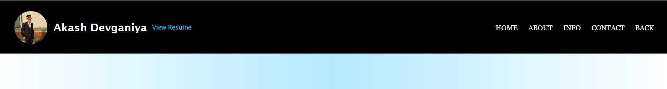
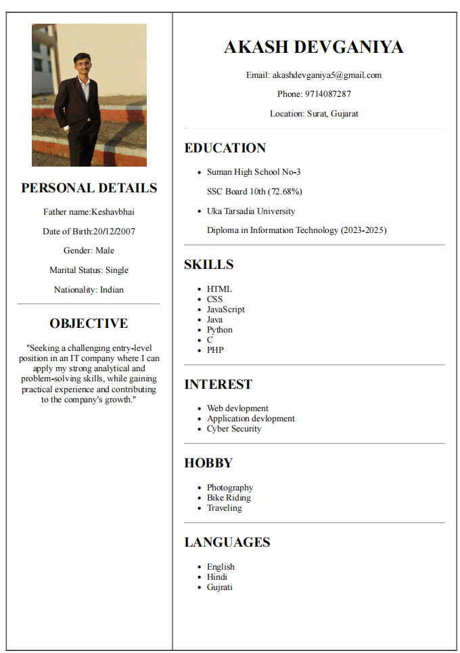
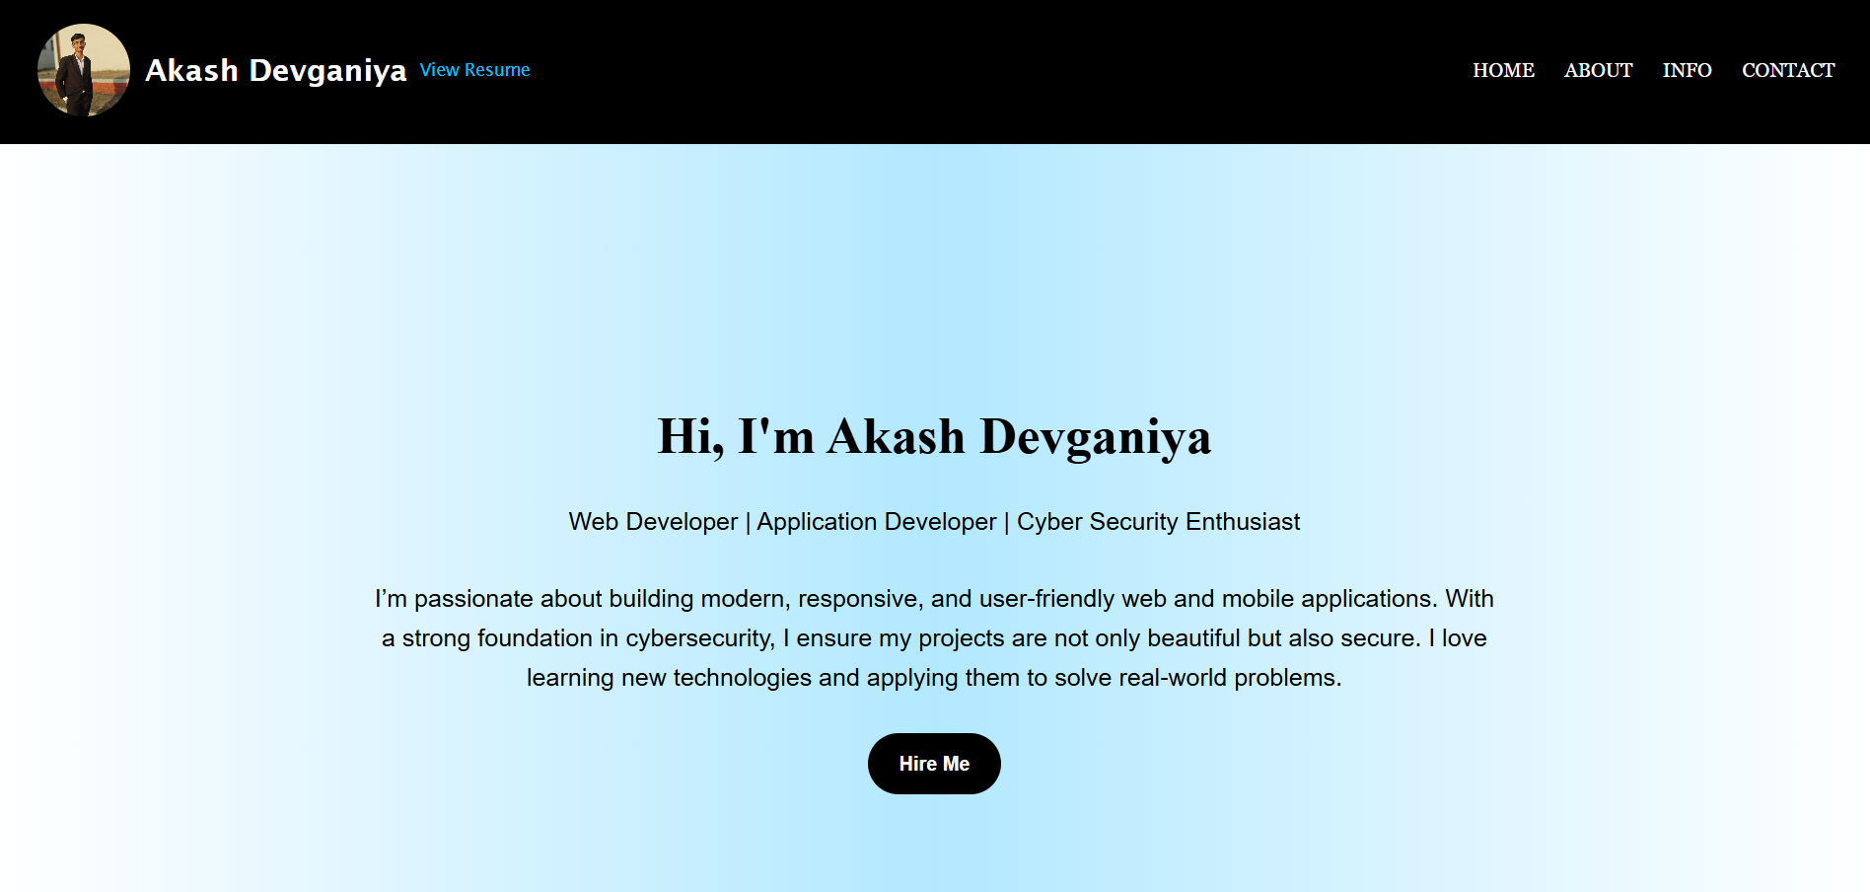
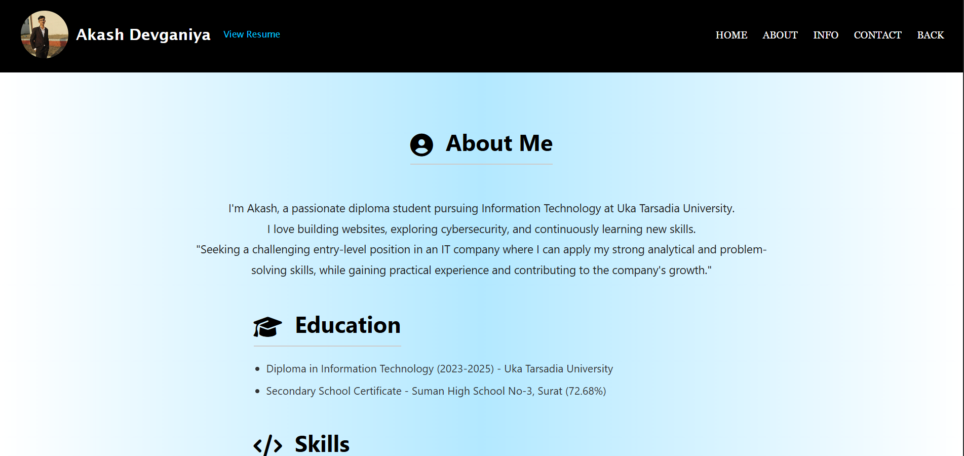
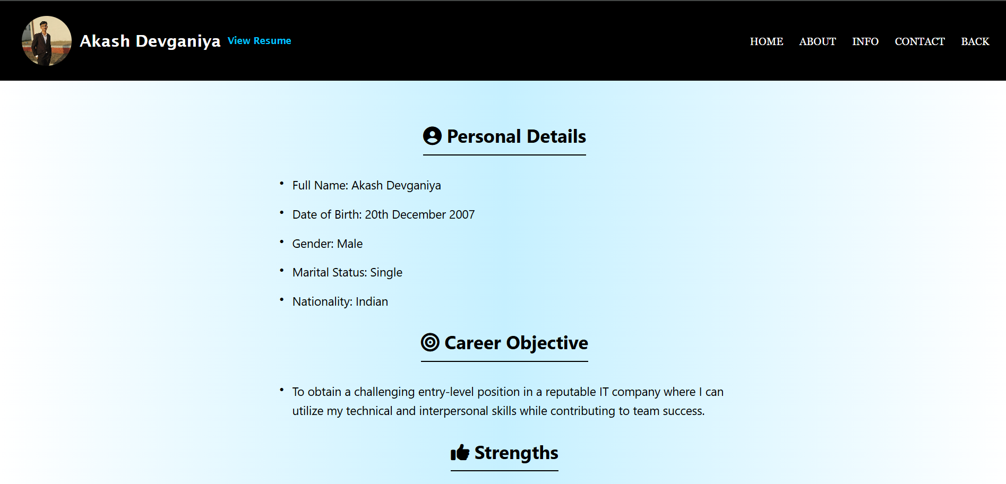
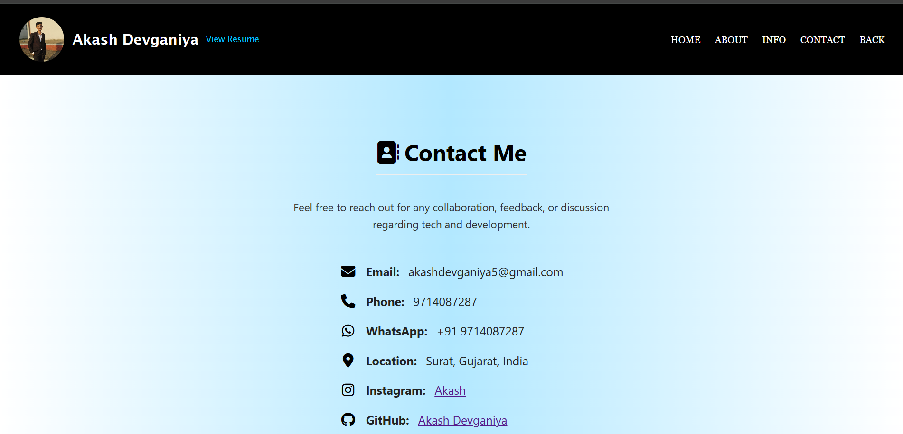
Implementation

Slide 11
Pages & Sections
Home: Intro, tagline, skills etc..
About: Bio, education, career goal etc..
Personal Info: DOB, gender, nationality etc..
Contact: Email, phone, location etc..
Extra: Resume, Hire Me CTA

Slide 12
Conclusion
Built a real website with pure HTML & CSS.
Improved design, layout & responsive coding skills.
Showcases personal & professional details online.
Useful for future portfolio and career.

Slide 13

ThankYou

